Slide 1
Introduction to Data Wrangling

Slide 2

Data Wrangling
Real-world data is NOT clean!!
We have to process it. More efficiency, better time use.
This is where dplyr comes in: aka A Grammar of Data Manipulation.
Hadley Wickham, 2014

Slide 3
Installing Package dplyr
You can use the install.packages command to install the dplyr package.
After installing the package, you can load it into the workspace using the library command. Note that while you only need to install a package once, you need to load it into the workspace whenever you want to access it.
Alternatively, recall that dplyr gets loaded automatically once you call tidyverse package, so you can skip this step.
> install.packages("dplyr")
> library(dplyr)
Attaching package: ‘dplyr’
The following object is masked from ‘package:MASS’:
select
The following objects are masked from ‘package:stats’:
filter, lag
The following objects are masked from ‘package:base’:
intersect, setdiff, setequal, union
What is this telling us?
If we just type the object name, we get the object in the last package loaded. i.e., order matters. What is we want select from the MASS package?
> MASS::select

Slide 4


Slide 5
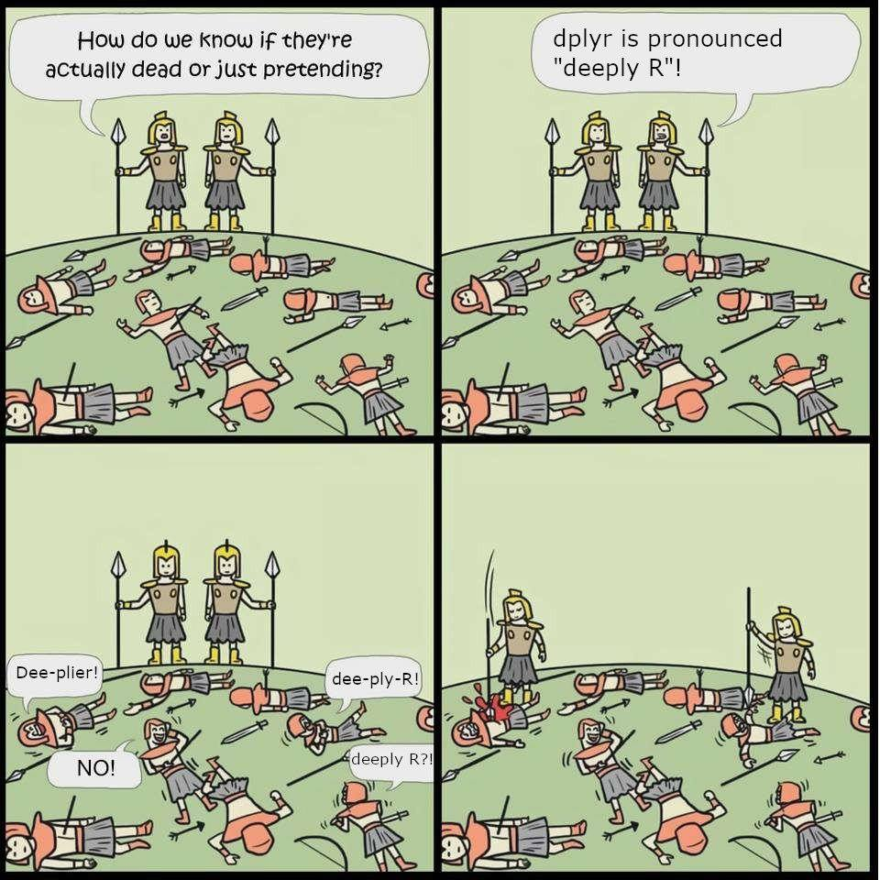

Slide 6
Our 1st function!: The select Function
The select function allows you to create a new data frame that is a subset of an existing data frame by choosing a set of the columns of the original data frame.
The general syntax is select(data_frame, Var_name_1, Var_name_2,…). Note that the entire column is transferred to the new data frame by the select function.

Slide 7
The filter Function
The filter function allows you to create a new data frame that is a subset of an existing data frame by choosing a set of the rows of the original data frame based on a collection of specified conditions.
The general syntax is filter(data_frame, Condition,…). The condition can include logical operators for the row selection. Note that the entire row is transferred to the new data frame by the filter function.

Slide 8
Examples from the Cars93 Data Frame
Recall the Cars93 data frame contains data for 93 cars sold in the U.S. during the year 1993. The first six rows of the data frame can be viewed using the head function.
> head(Cars93)
Manufacturer Model Type Min.Price Price Max.Price MPG.city MPG.highway AirBags DriveTrain
1 Acura Integra Small 12.9 15.9 18.8 25 31 None Front
2 Acura Legend Midsize 29.2 33.9 38.7 18 25 Driver & Passenger Front
3 Audi 90 Compact 25.9 29.1 32.3 20 26 Driver only Front
4 Audi 100 Midsize 30.8 37.7 44.6 19 26 Driver & Passenger Front
5 BMW 535i Midsize 23.7 30.0 36.2 22 30 Driver only Rear
6 Buick Century Midsize 14.2 15.7 17.3 22 31 Driver only Front
Cylinders EngineSize Horsepower RPM Rev.per.mile Man.trans.avail Fuel.tank.capacity Passengers Length
1 4 1.8 140 6300 2890 Yes 13.2 5 177
2 6 3.2 200 5500 2335 Yes 18.0 5 195
3 6 2.8 172 5500 2280 Yes 16.9 5 180
4 6 2.8 172 5500 2535 Yes 21.1 6 193
5 4 3.5 208 5700 2545 Yes 21.1 4 186
6 4 2.2 110 5200 2565 No 16.4 6 189
Wheelbase Width Turn.circle Rear.seat.room Luggage.room Weight Origin Make
1 102 68 37 26.5 11 2705 non-USA Acura Integra
2 115 71 38 30.0 15 3560 non-USA Acura Legend
3 102 67 37 28.0 14 3375 non-USA Audi 90
4 106 70 37 31.0 17 3405 non-USA Audi 100
5 109 69 39 27.0 13 3640 non-USA BMW 535i
6 105 69 41 28.0 16 2880 USA Buick Century

Slide 9
The select Function: Cars93 Example
> Cars93_Ex1<-select(Cars93,Type,EngineSize,DriveTrain,MPG.city)
> head(Cars93_Ex1)
Type EngineSize DriveTrain MPG.city
1 Small 1.8 Front 25
2 Midsize 3.2 Front 18
3 Compact 2.8 Front 20
4 Midsize 2.8 Front 19
5 Midsize 3.5 Rear 22
6 Midsize 2.2 Front 22
Notes:
An arbitrary number of variable names can be passed into the function.
The order of the variables in the new data frame matches the order they are entered into the function.
The variable names are not in quotations in the function input.

Slide 10
The filter Function: Cars93 Example
> Cars93_Ex2<-filter(Cars93, Type=="Small")
> head(Cars93_Ex2)
Manufacturer Model Type Min.Price Price Max.Price MPG.city MPG.highway AirBags DriveTrain Cylinders
1 Acura Integra Small 12.9 15.9 18.8 25 31 None Front 4
2 Dodge Colt Small 7.9 9.2 10.6 29 33 None Front 4
3 Dodge Shadow Small 8.4 11.3 14.2 23 29 Driver only Front 4
4 Eagle Summit Small 7.9 12.2 16.5 29 33 None Front 4
5 Ford Festiva Small 6.9 7.4 7.9 31 33 None Front 4
6 Ford Escort Small 8.4 10.1 11.9 23 30 None Front 4
EngineSize Horsepower RPM Rev.per.mile Man.trans.avail Fuel.tank.capacity Passengers Length Wheelbase
1 1.8 140 6300 2890 Yes 13.2 5 177 102
2 1.5 92 6000 3285 Yes 13.2 5 174 98
3 2.2 93 4800 2595 Yes 14.0 5 172 97
4 1.5 92 6000 2505 Yes 13.2 5 174 98
5 1.3 63 5000 3150 Yes 10.0 4 141 90
6 1.8 127 6500 2410 Yes 13.2 5 171 98
Width Turn.circle Rear.seat.room Luggage.room Weight Origin Make
1 68 37 26.5 11 2705 non-USA Acura Integra
2 66 32 26.5 11 2270 USA Dodge Colt
3 67 38 26.5 13 2670 USA Dodge Shadow
4 66 36 26.5 11 2295 USA Eagle Summit
5 63 33 26.0 12 1845 USA Ford Festiva
6 67 36 28.0 12 2530 USA Ford Escort
The == is a test for equality and we need to enter the “Small” in quotations since we are filtering for rows where the Type variable is equal to “Small”.

Slide 11
Combining the filter and select Functions
> Cars93_Ex3<-select(filter(Cars93, Type=="Small"),Model,EngineSize,Horsepower,MPG.highway)
> head(Cars93_Ex3)
Model EngineSize Horsepower MPG.highway
1 Integra 1.8 140 31
2 Colt 1.5 92 33
3 Shadow 2.2 93 29
4 Summit 1.5 92 33
5 Festiva 1.3 63 33
6 Escort 1.8 127 30
If I wanted to include the value 150, I would use
Horsepower>=150
> Cars93_Ex4<-select(filter(Cars93, Horsepower>150),Model,EngineSize,Horsepower,MPG.highway)
> head(Cars93_Ex4)
Model EngineSize Horsepower MPG.highway
1 Legend 3.2 200 25
2 90 2.8 172 26
3 100 2.8 172 26
4 535i 3.5 208 30
5 LeSabre 3.8 170 28
6 Roadmaster 5.7 180 25
In this example the functions are nested, and the operations are completed from the inside out. We will see shortly another way to perform this nesting that is more readable.

Slide 12
Combining the filter and select Functions
> Cars93_Ex5<-select(filter(Cars93, Horsepower>120 & Type=="Small"),
+ Model,EngineSize,Horsepower,MPG.highway)
> head(Cars93_Ex5)
Model EngineSize Horsepower MPG.highway
1 Integra 1.8 140 31
2 Escort 1.8 127 30
3 Elantra 1.8 124 29
Here we have used the & operator which means we are filtering for Small cars that also have more than 120 Horsepower. That is, both conditions must be satisfied to pass through the filter. We note that only 3 cars in the data set satisfy this requirement.
> Cars93_Ex6<-select(filter(Cars93, Type=="Midsize"|Cylinders==4),
+ Model,Type,EngineSize,Cylinders,Horsepower,MPG.highway)
> head(Cars93_Ex6)
Model Type EngineSize Cylinders Horsepower MPG.highway
1 Integra Small 1.8 4 140 31
2 Legend Midsize 3.2 6 200 25
3 100 Midsize 2.8 6 172 26
4 535i Midsize 3.5 4 208 30
5 Century Midsize 2.2 4 110 31
6 Riviera Midsize 3.8 6 170 27
Here we have used the | operator which means we are filtering for cars that are Midsize or that have 4 Cylinders. That is, if either (or both) conditions are met the row passes through the filter.

Slide 13
The %in% Operator
A long list of criteria can be cumbersome to type. We can use the %in% operator to check whether a value is in a list of possible values.
> Cars93_Ex7<-select(filter(Cars93, Type %in% c("Sporty","Compact") & Horsepower >=120),
+ Model,Type,EngineSize,Cylinders,Horsepower,MPG.highway)
> head(Cars93_Ex7)
Model Type EngineSize Cylinders Horsepower MPG.highway
1 90 Compact 2.8 6 172 26
2 Camaro Sporty 3.4 6 160 28
3 Corvette Sporty 5.7 8 300 25
4 LeBaron Compact 3.0 4 141 28
5 Stealth Sporty 3.0 6 300 24
6 Prelude Sporty 2.3 4 160 31
Here, the cars are returned that have a Type of either Sporty or Compact and have Horsepower greater than 120.

Slide 14
The %>% Operator
When we have several operations to complete that need to be nested, using the pipe operator %>% can result in more readable code. That is, pipe-forwarding is an alternative to nesting.
> Cars93_Ex8<-Cars93 %>%
+ filter(Type %in% c("Sporty","Compact") & Horsepower >=120) %>%
+ select(Model,Type,EngineSize,Cylinders,Horsepower,MPG.highway)
> head(Cars93_Ex8)
Model Type EngineSize Cylinders Horsepower MPG.highway
1 90 Compact 2.8 6 172 26
2 Camaro Sporty 3.4 6 160 28
3 Corvette Sporty 5.7 8 300 25
4 LeBaron Compact 3.0 4 141 28
5 Stealth Sporty 3.0 6 300 24
6 Prelude Sporty 2.3 4 160 31
The pipeline above accomplishes the same set of operations as the code from the last slide.
> Cars93_Ex7<-select(filter(Cars93, Type %in% c("Sporty","Compact") & Horsepower >=120),
+ Model,Type,EngineSize,Cylinders,Horsepower,MPG.highway)

Slide 15
The mutate Function
The mutate function allows you to create a new data frame consisting of the original data frame with a column appended on the right end.
The general syntax is mutate(data_frame, Var_Name = function(…)). The new column will have the name given in Var_Name and be computed from the function provided.

Slide 16
Example of the mutate Function
We now add a column to the Cars93 data frame containing the horsepower per liter of engine size. That is, we define the new variable HPpLiter by the function
> Cars93_Ex9<-select(mutate(Cars93,HPpLiter=Horsepower/EngineSize),
+ Model,Type,EngineSize,Cylinders,Horsepower,MPG.highway,HPpLiter)
> head(Cars93_Ex9)
Model Type EngineSize Cylinders Horsepower MPG.highway HPpLiter
1 Integra Small 1.8 4 140 31 77.77778
2 Legend Midsize 3.2 6 200 25 62.50000
3 90 Compact 2.8 6 172 26 61.42857
4 100 Midsize 2.8 6 172 26 61.42857
5 535i Midsize 3.5 4 208 30 59.42857
6 Century Midsize 2.2 4 110 31 50.00000
We could have also written this using the equivalent pipeline
> Cars93_Ex9<-Cars93 %>%
+ mutate(HPpLiter=Horsepower/EngineSize) %>%
+ select(Model,Type,EngineSize,Cylinders,Horsepower,MPG.highway,HPpLiter)

Slide 17
The arrange Function
The arrange function allows you to sort a data frame by variable producing a new data frame ordered by that variable.
The general syntax is arrange(data_frame, Var_Name1, Var_Name2, …). The rows are sorted by the variables selected in the order they are entered. That is, on Var_Name1 first, with ties broken by Var_Name2, etc. The default is ascending order, and descending order can be selected by using desc(Var_Name1) when passing in the variable name.

Slide 18
Example of the arrange Function
In the previous example we used the mutate function to add a column to the Cars93 data frame containing the horsepower per liter. We now sort this new data frame first by the number of cylinders and then by the engine's horsepower.
> Cars93_Ex10<-arrange(Cars93_Ex9,Cylinders,desc(Horsepower))
> head(Cars93_Ex10)
Model Type EngineSize Cylinders Horsepower MPG.highway HPpLiter
1 Justy Small 1.2 3 73 37 60.83333
2 Swift Small 1.3 3 70 43 53.84615
3 Metro Small 1.0 3 55 50 55.00000
4 535i Midsize 3.5 4 208 30 59.42857
5 626 Compact 2.5 4 164 34 65.60000
6 Prelude Sporty 2.3 4 160 31 69.56522
This could have been accomplished without the previous work using the pipeline
> Cars93_Ex10<-Cars93 %>%
+ mutate(HPpLiter=Horsepower/EngineSize) %>%
+ select(Model,Type,EngineSize,Cylinders,Horsepower,MPG.highway,HPpLiter) %>%
+ arrange(Cylinders,desc(Horsepower))
Observe that we used desc(Horsepower) to sort on this variable from highest to lowest.

Slide 19
The rename Function
The rename function allows you to rename columns in a data frame.
The syntax is rename(data_frame, New_Name1=Old_Name1, New_Name2=Old_Name2 …). The variable named Old_Name is renamed with the value entered for New_Name in the output data frame. Rows are not affected, and the column order remains unchanged.
Example: We can rename two of the columns in the data frame from the previous example using the rename function as follows:
> Cars93_Ex11<-rename(Cars93_Ex10,HP=Horsepower,MPG_Highway=MPG.highway)
> head(Cars93_Ex11)
Model Type EngineSize Cylinders HP MPG_Highway HPpLiter
1 Justy Small 1.2 3 73 37 60.83333
2 Swift Small 1.3 3 70 43 53.84615
3 Metro Small 1.0 3 55 50 55.00000
4 535i Midsize 3.5 4 208 30 59.42857
5 626 Compact 2.5 4 164 34 65.60000
6 Prelude Sporty 2.3 4 160 31 69.56522

Slide 20
More Examples with the mutate Function
Suppose we are interested in the engines of the various cars. We previously used the mutate function to add a column containing the horsepower per liter of engine size.
> head(Cars93_Ex11)
Model Type EngineSize Cylinders HP MPG_Highway HPpLiter
1 Justy Small 1.2 3 73 37 60.83333
2 Swift Small 1.3 3 70 43 53.84615
3 Metro Small 1.0 3 55 50 55.00000
4 535i Midsize 3.5 4 208 30 59.42857
5 626 Compact 2.5 4 164 34 65.60000
6 Prelude Sporty 2.3 4 160 31 69.56522
What if we wanted the data in the HPpLiter column to be rounded to the nearest tenth? (Note that we could have done this when we first added the column, but we forgot). We can use the mutate function to accomplish this as well.
> Cars93_Ex12<-mutate(Cars93_Ex11,HPpLiter=round(HPpLiter,1))
Observe that we have entered a variable name that is already in the data frame. How does the mutate function process this request?

Slide 21
More Examples with the mutate Function
Viewing the function output produces
> head(Cars93_Ex12)
Model Type EngineSize Cylinders HP MPG_Highway HPpLiter
1 Justy Small 1.2 3 73 37 60.8
2 Swift Small 1.3 3 70 43 53.8
3 Metro Small 1.0 3 55 50 55.0
4 535i Midsize 3.5 4 208 30 59.4
5 626 Compact 2.5 4 164 34 65.6
6 Prelude Sporty 2.3 4 160 31 69.6
The mutate function did not append a new column on the end of the data frame, but rather replaced the existing column with the matching name with the updated information.
Suppose that engines producing 65 horsepower or more per liter of displacement can be considered high-performance while those producing less than this value are regular performance. How can we add a column indicating this to our data frame?

Slide 22
More Examples with the mutate Function
We can combine the mutate function with the ifelse function to obtain this result
> Cars93_Ex13<-mutate(Cars93_Ex12,Performance=ifelse(HPpLiter>=65,"High","Regular"))
> head(Cars93_Ex13)
Model Type EngineSize Cylinders HP MPG_Highway HPpLiter Performance
1 Justy Small 1.2 3 73 37 60.8 Regular
2 Swift Small 1.3 3 70 43 53.8 Regular
3 Metro Small 1.0 3 55 50 55.0 Regular
4 535i Midsize 3.5 4 208 30 59.4 Regular
5 626 Compact 2.5 4 164 34 65.6 High
6 Prelude Sporty 2.3 4 160 31 69.6 High
The mutate function appends the result of the ifelse function on the right side of the data frame. Note that the format of the ifelse function is ifelse(condition, what if true, what if false). We can obtain further information using
> table(Cars93_Ex13$Performance)
High Regular
16 77

Slide 23
More Examples with the mutate Function
The ifelse statements can also be nested. As an example, suppose we have three classifications for the Performance variable.
> Cars93_Ex14<-Cars93_Ex13 %>%
+ mutate(Performance=ifelse(HPpLiter>=65,"High",ifelse(HPpLiter>=55,"Regular","Low")))
> head(Cars93_Ex14)
Model Type EngineSize Cylinders HP MPG_Highway HPpLiter Performance
1 Justy Small 1.2 3 73 37 60.8 Regular
2 Swift Small 1.3 3 70 43 53.8 Low
3 Metro Small 1.0 3 55 50 55.0 Regular
4 535i Midsize 3.5 4 208 30 59.4 Regular
5 626 Compact 2.5 4 164 34 65.6 High
6 Prelude Sporty 2.3 4 160 31 69.6 High
Here the mutate function replaces the existing Performance column with the updated values which has High for engines with 65 HPpLiter or more, Regular for those satisfying 55 < HPpLiter < 65 and Low performance for engines with HPpLiter < 55. We can get counts using
> table(Cars93_Ex14$Performance)
High Low Regular
16 48 29

Slide 24
Tibbles, Row Names, and dplyr
The package dplyr is part of the Tidyverse, a collection of packages “designed to work together to make common data science operations more user friendly.”
There are several differences between how the tidyverse views data objects and how traditional R views them. Two important distinctions
The data frame has been replaced by the tibble as the basic data object.
Row names have been deprecated.
NOTE: A large number of tidyverse functions will work with both tibbles and dataframes, and the data structure of the output will be identical to the input. However, there are some functions that will return a tibble (without row names), whether or not a tibble or dataframe is provided.

Slide 25
Tibbles
A core component of the tidyverse is the tibble. Tibbles are a modern rework of the standard data.frame, with some internal improvements to make code more reliable. They are similar to data frames, but do not follow all of the same rules. For example, tibbles can have numbers/symbols for column names, which is not allowed in base R.
If you use a function from the dplyr package that returns a tibble as output, you can convert it to a data frame using the data.frame function. For example
> Result
# A tibble: 3 x 4
cyl N Mean_HP Mean_mpg
<dbl> <int> <dbl> <dbl>
1 4 11 82.6 26.7
2 6 7 122. 19.7
3 8 14 209. 15.1
> Result<-data.frame(Result)
> Result
cyl N Mean_HP Mean_mpg
1 4 11 82.63636 26.66364
2 6 7 122.28571 19.74286
3 8 14 209.21429 15.10000

Slide 26
rownames and dplyr
Important: tidyverse is very opinionated about row names. These packages insist that all column data (e.g. data.frame) be treated equally, and that special designation of a column as rownames should be deprecated. Package tibble provides simple utility functions to handle rownames: rownames_to_column and column_to_rownames.
> head(mammals)
body brain
Arctic fox 3.385 44.5
Owl monkey 0.480 15.5
Mountain beaver 1.350 8.1
Cow 465.000 423.0
Grey wolf 36.330 119.5
Goat 27.660 115.0
> has_rownames(mammals)
[1] TRUE
> head(mammals_rn)
Mammal body brain
1 Arctic fox 3.385 44.5
2 Owl monkey 0.480 15.5
3 Mountain beaver 1.350 8.1
4 Cow 465.000 423.0
5 Grey wolf 36.330 119.5
6 Goat 27.660 115.0
> mammals_rn<-rownames_to_column(mammals, "Mammal")
> has_rownames(mammals_rn)
[1] FALSE

Slide 27
rownames and dplyr
What if you want the row names to function as rownames? For example, what if you have an R function that uses the row names of an object to perform some kind of task?
There are two ways to handle this:
1. Make a new data frame with the row names.
> head(mammals_rn, 5)
Mammal body brain
1 Arctic fox 3.385 44.5
2 Owl monkey 0.480 15.5
3 Mountain beaver 1.350 8.1
4 Cow 465.000 423.0
5 Grey wolf 36.330 119.5
> mammals_2<-column_to_rownames(mammals_rn,"Mammal")
> head(mammals_2, 5)
body brain
Arctic fox 3.385 44.5
Owl monkey 0.480 15.5
Mountain beaver 1.350 8.1
Cow 465.000 423.0
Grey wolf 36.330 119.5
2. Pass in the argument to the function by first applying the column_to_rownames function on the data frame.
> function(mammals_rn, optional arg1,... )
> function(column_to_rownames(mammals_rn,"Mammal"), optional arg1, ... )

Slide 28
The summarize Function
The summarize function allows you to produce a data frame with user chosen statistics calculated from the columns of the input data frame.
Often used with the group_by function which allows the statistics to be computed for particular groups in the input data frame.
Example: We have the data on the engines in the Cars93_Ex14 data frame.
> head(Cars93_Ex14)
Model Type EngineSize Cylinders HP MPG_Highway HPpLiter Performance
1 Justy Small 1.2 3 73 37 60.8 Regular
2 Swift Small 1.3 3 70 43 53.8 Low
3 Metro Small 1.0 3 55 50 55.0 Regular
4 535i Midsize 3.5 4 208 30 59.4 Regular
5 626 Compact 2.5 4 164 34 65.6 High
6 Prelude Sporty 2.3 4 160 31 69.6 High
We can use the summarize function to obtain information about the engines grouped by, for example, the car Type or the Cylinders variable.

Slide 29
The summarize Function
An example of the summarize function is provided in the following pipeline:
> Engine_Summary<-Cars93_Ex14 %>%
+ group_by(Type) %>%
+ summarise(Num=n(),Min_Size=min(EngineSize),Max_Size=max(EngineSize),Ave_HP=mean(HP),
+ Median_MPG_HWY=median(MPG_Highway),Num_High_Performance=sum(Performance=="High"))
`summarise()` ungrouping output (override with `.groups` argument)
> Engine_Summary<-data.frame(Engine_Summary)
> Engine_Summary
Type Num Min_Size Max_Size Ave_HP Median_MPG_HWY Num_High_Performance
1 Compact 16 2.0 3.0 131.0000 30.0 4
2 Large 11 3.3 5.7 179.4545 26.0 0
3 Midsize 22 2.0 4.6 173.0909 26.5 4
4 Small 21 1.0 2.2 91.0000 33.0 5
5 Sporty 14 1.3 5.7 160.1429 28.5 3
6 Van 9 2.4 4.3 149.4444 22.0 0
The code above creates five new variables of interest and calculates them for the groups determined by the group_by function. The n() function gives the number of units in the group. The output of the function is a tibble we convert to a data frame using the data.frame function.

Slide 30
Example of the summarize Function
A second example of the summarize function is provided in the following pipeline:
> Engine_Summary_2<-Cars93_Ex14 %>%
+ group_by(Cylinders) %>%
+ summarise(Num=n(),Min_Size=min(EngineSize),Max_Size=max(EngineSize),Ave_HP=mean(HP),
+ Median_MPG_HWY=median(MPG_Highway),Num_High_Performance=sum(Performance=="High"))
`summarise()` ungrouping output (override with `.groups` argument)
> Engine_Summary_2<-data.frame(Engine_Summary_2)
> Engine_Summary_2
Cylinders Num Min_Size Max_Size Ave_HP Median_MPG_HWY Num_High_Performance
1 3 3 1.0 1.3 66.0000 43.0 0
2 4 49 1.3 3.5 113.4694 31.0 10
3 5 2 2.4 2.5 138.5000 24.5 1
4 6 31 2.8 5.7 175.5806 26.0 4
5 8 7 4.5 5.7 234.7143 25.0 0
6 rotary 1 1.3 1.3 255.0000 25.0 1
The same five new variables of interest are calculated but this time the engines are grouped by the Cylinders variable. Again, we which we convert the tibble output to a data frame using the data.frame function.

